Slide 1
QuEST

Slide 2
QuEST
Laboratory for Quantum Enhanced Systems and Technology

Slide 3
QuEST
Thanks for QuEST with us
Laboratory for Quantum Enhanced Systems and Technology

Slide 4
QuEST
Laboratory for Quantum Enhanced Systems and Technology

Slide 5
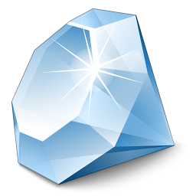
Nano Engineering
Quantum Chips
Green Energy
Quantum Power
Information Processing
Quantum
Coherence
Measurement & Treatment
Biomedical
Quantum Internet

Slide 6
Nano Photonics
Quantum Computing
Remote Sensing
Quantum LiDAR
Information Processing
Quantum Engineering
Biomedical
Imaging,
Therapeutics
Quantum Internet

Slide 7
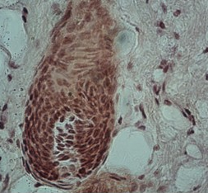

$$ψ$$

Slide 8
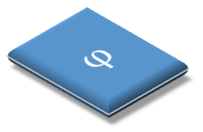



$$φ$$
$$φ$$
$$φ$$
Σ
$$φ$$

Slide 9
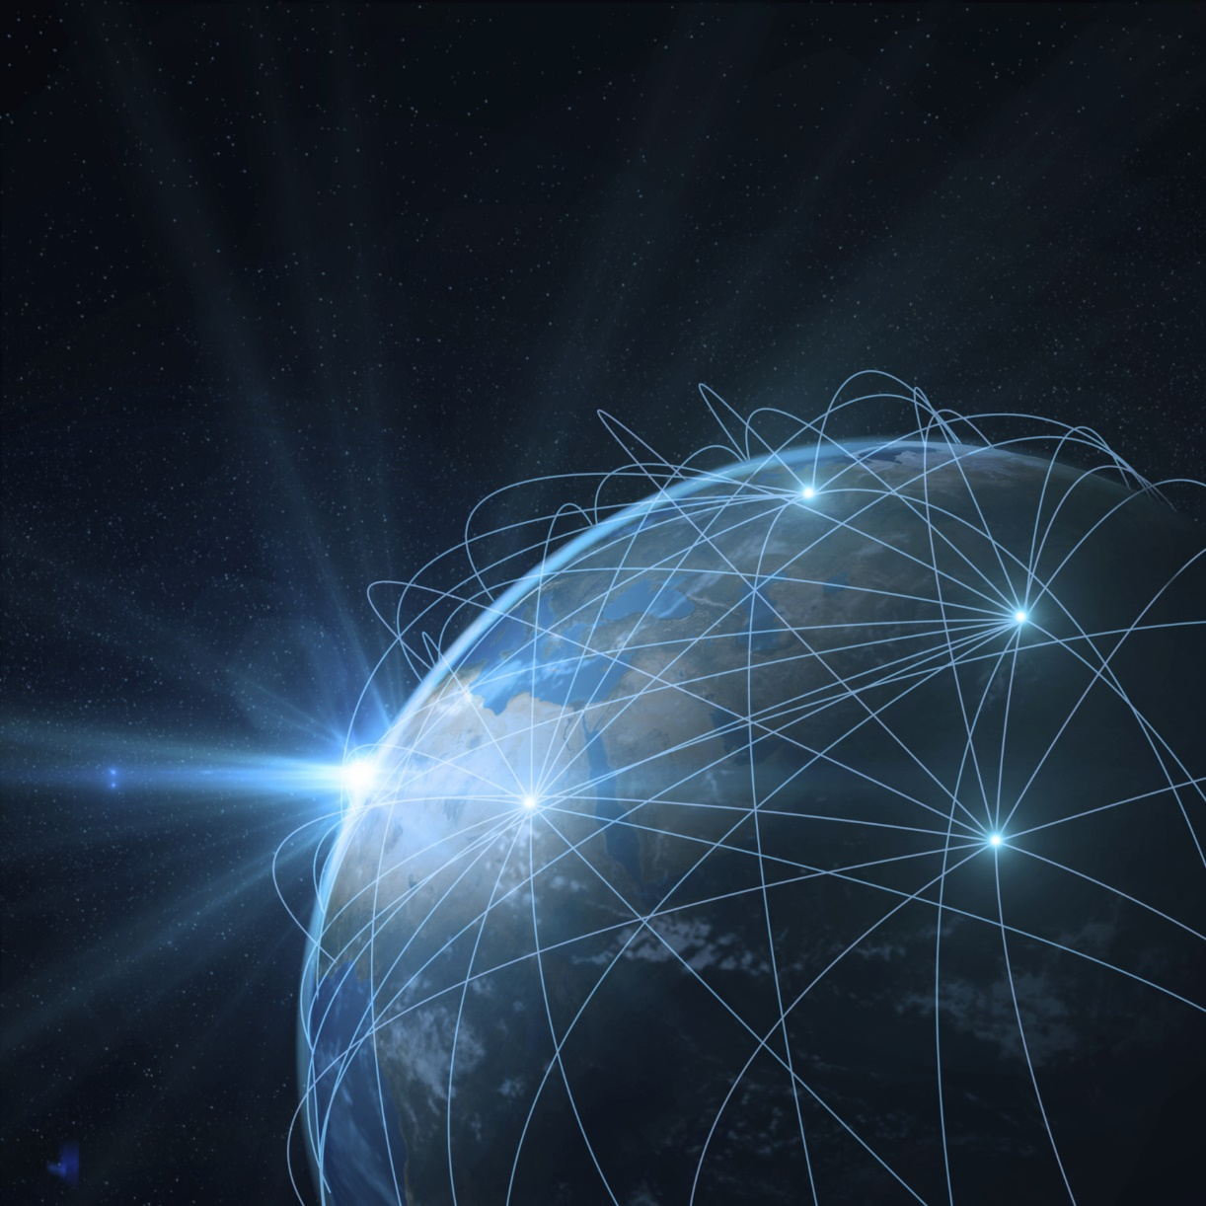
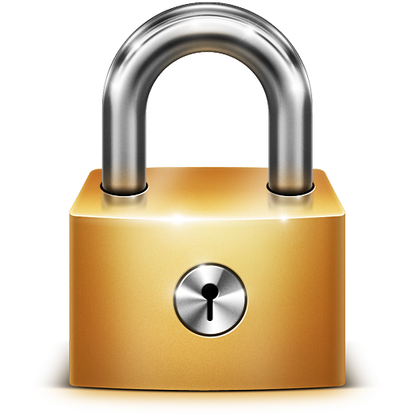

Slide 10
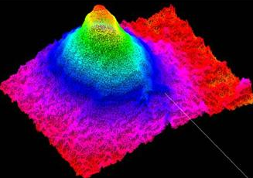
ѱ

Slide 11
1 cm

Slide 12
